Slide 1
Azure and Office 365 DevCamp - Overview

Slide 2
Course Goals
Provide a jumpstart on development for Azure and Office 365
Understand the options for your platform of choice
Windows, Linux, OSX
CODE, CODE, CODE

Slide 3
Course Agenda
Module 1
Module 2
Module 3
Module 4
Module 5
Module 6
Module 7
Setting up your developer environment
Building modern cloud apps
Identity with Azure AD and Office 365 APIs
DevOps with Azure and Visual Studio Team Services
Monitoring applications with App Insights
Introduction to Docker and Azure container service
Partner programs (App Source, Market place and CSP)

Slide 4
Hands on labs
HOL 1
HOL 2
HOL 3
HOL 4
HOL 5
Setting up your developer environment
Building modern cloud apps
Identity with Azure AD and Office 365 APIs
DevOps with Azure and Visual Studio Team Services
Monitoring applications with App Insights

Slide 5
Day 1 – Detailed Agenda
9:00 AM – 9:30
Overview
9:30 – 10:00
Tools and developer environment overview
10:00 – 10:30
HOL 1
10:30 – 10:45
Break
10:45 -11:15
HOL1 - Tools and Developer Environment Setup (Cont'd)
11:15 - 12:00 PM
Modern Cloud Apps (Overview Part 1)
12:00 -1:00
Lunch
1:00 - 2:30
HOL 2 - Modern Cloud Apps
2:30 - 2:45
2:45 - 3:45
Identity and Office365 APIs Overview
3:45 - 4:45
HOL 3 - Identity and Office365 APIs
4:45 - 5:00
Break
Q&A

Slide 6
Day 2 – Detailed Agenda

Slide 7
Demo – Sample Application

Slide 8
Sample Application Architecture

Slide 9
Architectural Components

Slide 10
Architectural Components Covered
Azure
Azure Resource Manager
Virtual Machines (Windows & Linux)
Azure AD
Web Applications
API Apps
Redis Cache
Document DB
Office 365
Graph API (users, OneDrive for Business, Skype for Business)
Visual Studio Team Services
Source Control integration (GIT)
Continuous Integration & Delivery
Mobile
Xamarin
Hockey App
Azure Mobile Services
Containers
Docker and Azure Container Service

Slide 11



Achieve global scale, in local regions
34
regions
Notes:
The security controls we apply to development, infrastructure, operations, and compliance apply to our global customer base. Customers can explicitly choose which regions to deploy and store their data according to local privacy, security, or compliance requirements.
On this slide you can see the 34 regions where we operate (26 are active), including:
Public cloud regional datacenters with geographic diversity. Customers can deploy two identical workloads in different regions with an Active/Active failover model. This can ensure business continuity in the event of a local disaster.
Local and sovereign cloud. In-country Microsoft datacenters address data residency requirements, and we’re using a combination of technology as well as a legal framework to legally isolate certain regions of the world according to local sovereignty, governance, and rule of law, all the while providing the same exact up to date set of services in those regions.
There are four sovereign clouds today and four more planned, including Germany for example, as well as:
US Gov (2)
China North Beijing
China South Shanghai
Planned:
Germany Central
Germany Northeast
US DoD East
US DoD West

Slide 12
Momentum
120,000
New Azure customer subscriptions/month
150 billion
Azure SQL query requests processed/day
>85%
of Fortune 500 use Microsoft Cloud
715 million
Azure Active Directory users
120 billion
Hits to websites run on Azure Web App Service
Notes:
We’ve had incredible momentum in the last year with over 85% of Fortune 500 companies using the Microsoft Cloud.

Slide 13
Microsoft Linux
Security
Docker

Slide 14
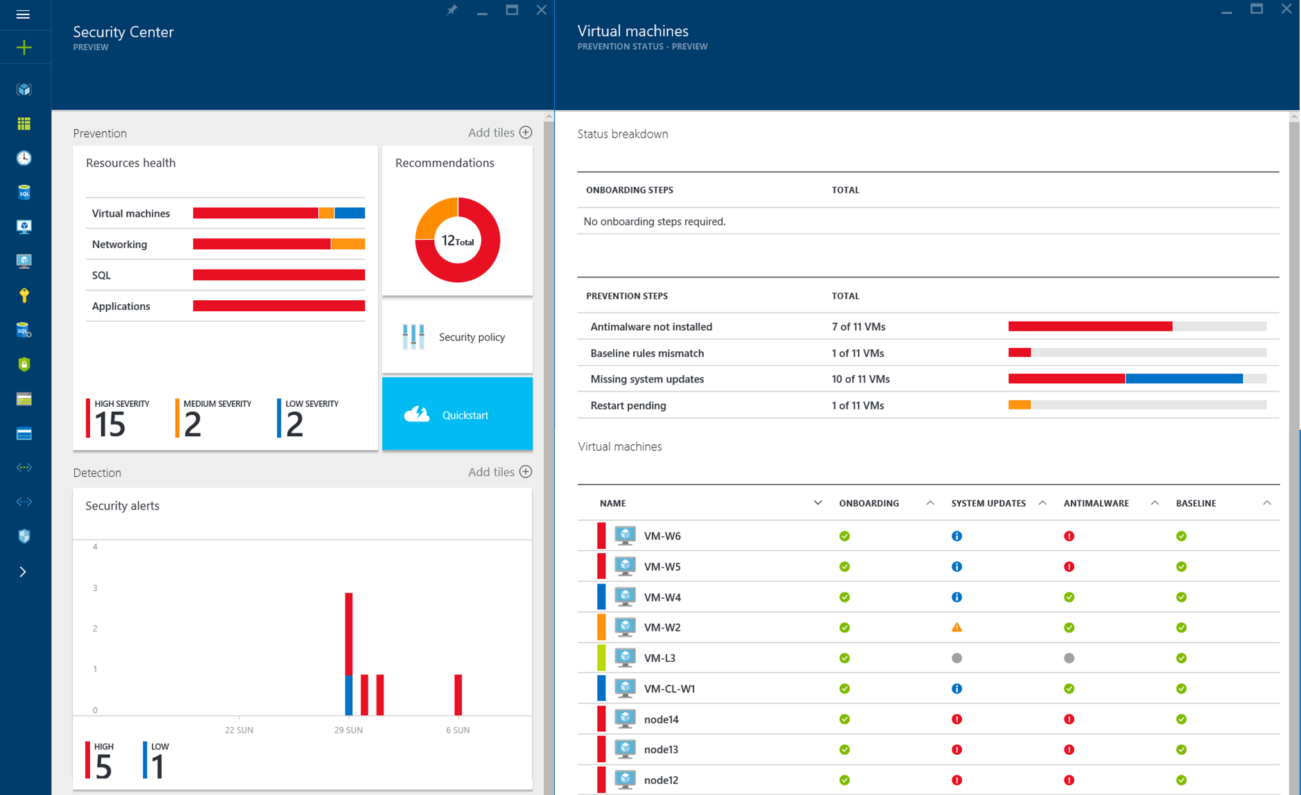
Detect and mitigate threats
Securing the platform
Empowering you
RED TEAM
BLUE TEAM
Notes:
Security is built into the services we provide to our customers, and embedded within our development processes, infrastructure, operations, and compliance.
Assume Breach is an example of operational innovation for securing your business. It is unique to Microsoft, and is a key operational practice that it uses to harden its cloud services. Here’s how it works:
The red team simulates real-world attacks at the network, platform, and application layers.
The blue team detects, protect against, and recovers.
Identifying and ejecting attackers, limiting what access an attacker would have if various layers were breached – we do this though techniques like segregation of duties, and how quickly we can restore the environment in the event of a breach. By constantly challenging the security capabilities of the service, Microsoft can stay ahead of emerging threats and be prepared to act quickly to threats.
On the right side, we provide services to empower you to protect your assets, for example,
Azure Security Center helps you prevent, detect and respond to threats with increased visibility and control over the security of all your Azure resources. It provides a central view of security across your subscriptions, and enables you to set policies and monitor security configurations. Policy-driven recommendations guide resource owners through the process of implementing security controls and enable rapid deployment of integrated Microsoft and partner security solutions. Security-related events from across your Azure deployments are automatically collected and analyzed using Microsoft global threat intelligence and expertise to identify actual threats and reduce false alarms. The resulting real-time alerts offer insights into the attack campaign and suggest ways to remediate and recover quickly.

Slide 15
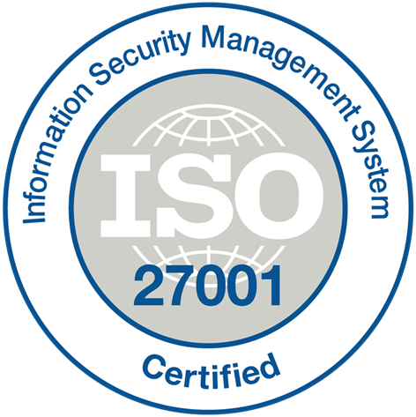

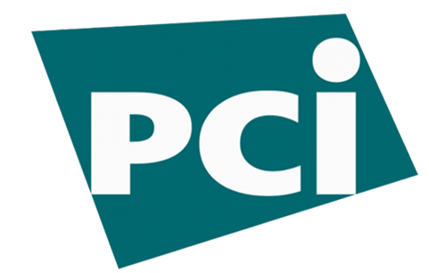

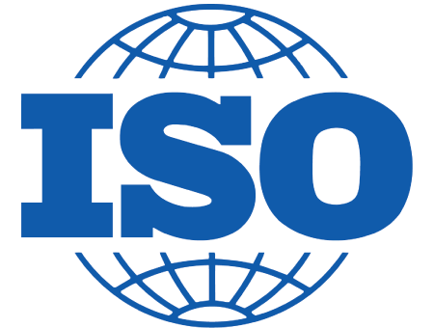























Benefit from relentless business commitment
ISO 27001
SOC 1 Type 2
SOC 2 Type 2
PCI DSS Level 1
Cloud Controls Matrix
ISO 27018
Content Delivery and Security Association
Shared
Assessments
FedRAMP
JAB P-ATO
HIPAA/ HITECH
FIPS 140-2
21 CFR
Part 11
FERPA
DISA Level 2
CJIS
IRS 1075
ITAR-ready
Section 508 VPAT
European Union Model Clauses
EU Safe Harbor
United Kingdom
G-Cloud
China Multi
Layer Protection
Scheme
China
GB 18030
China
CCCPPF
Singapore
MTCS Level 3
Australia
Signals
Directorate
New
Zealand GCIO
Japan
Financial Services
ENISA
IAF
Notes:
Finally, Azure is designed with an aggressive compliance strategy that helps customers address business objectives and industry standards & regulations. Our security compliance framework includes test and audit phases, security analytics, risk management best practices, and security benchmark analysis to achieve certificates and attestations.

Slide 16
Microsoft Linux
Hybrid
Docker

Slide 17
Extend on-premises data and apps
Storage | StorSimple + Azure Storage
Backup + DR | Azure Backup + Azure Site Recovery
Database | SQL Server 2016 Stretch DB + Azure SQL DB
App integration | Azure Service Bus + BizTalk
Identity | Azure Active Directory
Cloud management | Operations Management Suite + System Center
Networking | VPN + ExpressRoute
Hybrid
Notes:
ALTERNATE Hybrid Cloud Slide
With Azure, you can take the investments you’ve made in data and intellectual property, and extend from on-premises to the cloud, or vice versa.
Companies fall into two main buckets with regards to hybrid: those who are using hybrid solutions as a temporary bridge to the cloud, and companies who are architecting hybrid solutions for use in perpetuity.
Amongst each of these types of customers, there are common use cases such as:
Application Availability
Bottomless Storage
Identity Management
Full hybrid applications
But—this isn’t easy. That’s why we support hybrid solutions across key elements for hybrid: networking, identity, data, and apps.
[need combos of the displayed features to talk to the use cases]
Finally, Azure’s hybrid cloud capabilities support an open ecosystem:
Azure Marketplace
RedHat Linux on Azure
Hosters
Support for OSS App Platforms, languages, frameworks

Slide 18
Extend on-premises data and apps
Hybrid Use Cases
Seamless & secure across:
Application Availability
Bottomless Storage
Identity Management
Full hybrid applications
INFRASTRUCTURE
Azure Backup
Azure Site Recovery
DATA
Azure StorSimple
SQL Server Stretch DB
USERS
Azure Active Directory
APPS
App Service
Web | Mobile | Logic Apps | API Apps
MANAGEMENT
Operations Management Suite
Notes:
With Azure, you can take the investments you’ve made in data and intellectual property, and extend from on-premises to the cloud, or vice versa. Azure provides the portability to move your technology investments, whether open source or not, from cloud to on-premises and vice versa.
Companies fall into two main buckets with regards to hybrid: those who are using hybrid solutions as a temporary bridge to the cloud, and companies who are architecting hybrid solutions for use in perpetuity.
Amongst each of these types of customers, there are common use cases such as:
Application Availability
Bottomless Storage
Identity Management
Full hybrid applications
We provide seamless, secure hybrid cloud capabilities across infrastructure, data, users, apps, and management.

Slide 19
Deploy the cloud on-premises
Azure Stack
Portal | PowerShell | Dev-ops tools
Portal | PowerShell | Dev-ops tools
One Azure ecosystem
Azure Resource Manager
Azure Resource Manager
Unified app development
Azure IaaS | Azure PaaS
Azure IaaS | Azure PaaS
Compute | Networking | Storage
App Service | Service Fabric
Azure services in your datacenter
Cloud infrastructure
Cloud-inspired infrastructure
Microsoft Azure
PUBLIC
Microsoft Azure Stack
PRIVATE | HOSTED
Notes:
Azure Stack provides the capabilities of Azure for customers who want to host it on their own premises. The Azure portal acts as a hub for managing between cloud and on-premises.
On the left hand side, you have Microsoft Azure as a public cloud offering. Note that on the right, with Azure stack, the parity between key elements:
Portal | PowerShell | Dev-ops tools provide the same end user experiences and same app model.
Azure Resource Manager lets you build reusable application templates for traditional and cloud-native apps.
Azure IaaS and PaaS services are available in both for unified app dev.
On the infrastructure layer, we are making some translation – Azure runs on hyper-scale (each scale unit is 20 racks!) while you folks likely run a lesser footprint. So we’re doing some work to make this fit into your environments.
This provides some key benefits across roles:
Application developers can maximize their productivity using a ‘write once, deploy to Azure or Azure Stack’ approach. Using APIs that are identical to Microsoft Azure, they can create applications based on open source or .NET technology that can easily run on-premises or in the public cloud. They can also leverage the rich Azure ecosystem to jumpstart their Azure Stack development efforts.
IT professionals can help transform on-premises datacenter resources into Azure-consistent IaaS and PaaS services, thereby maximizing agility and efficiency. End users can quickly provision services using the same self-service experience as Azure. IT gets to use the same automation tools as Azure to control the service delivery experience.
Business leaders can truly take advantage of cloud on your terms.

Slide 20
Microsoft Linux
Linux
Docker

Slide 21

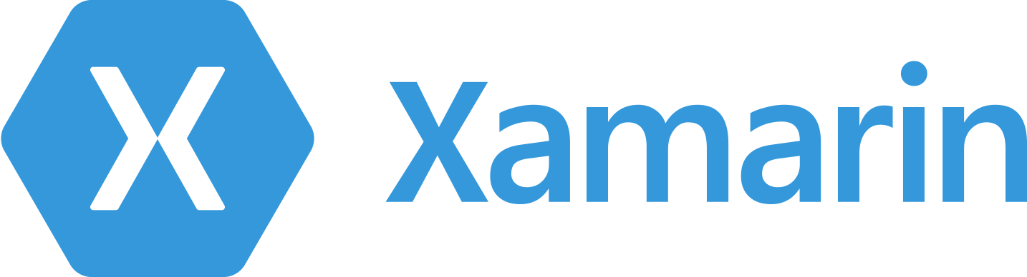



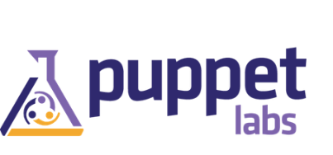

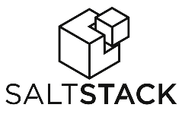











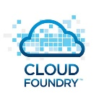















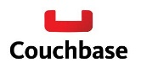





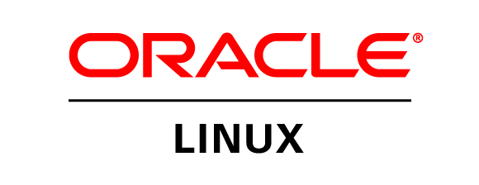
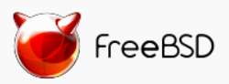


Azure is an open cloud
Public Cloud
DevOps
Clients
Management
Applications
PaaS &
DevOps
App Frameworks
& Tools
Databases &
Middleware
Infrastructure

Slide 22







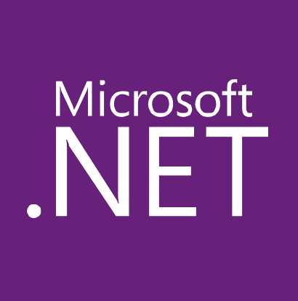

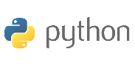
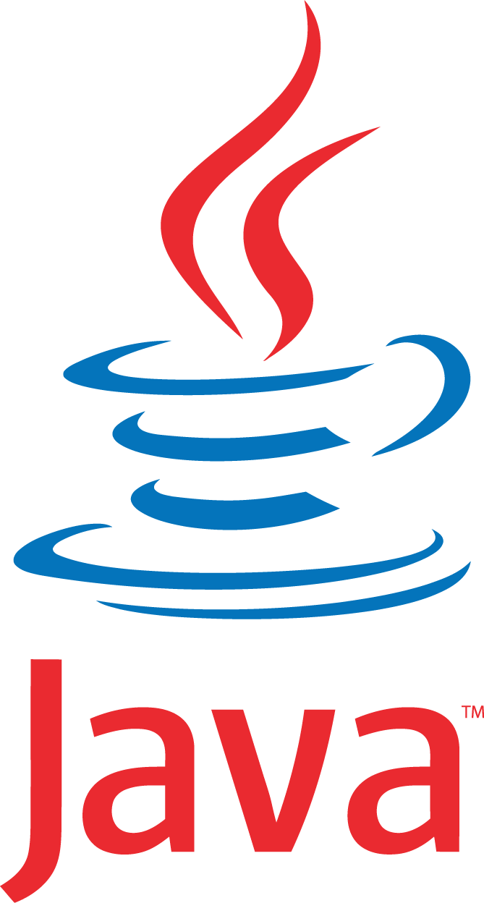








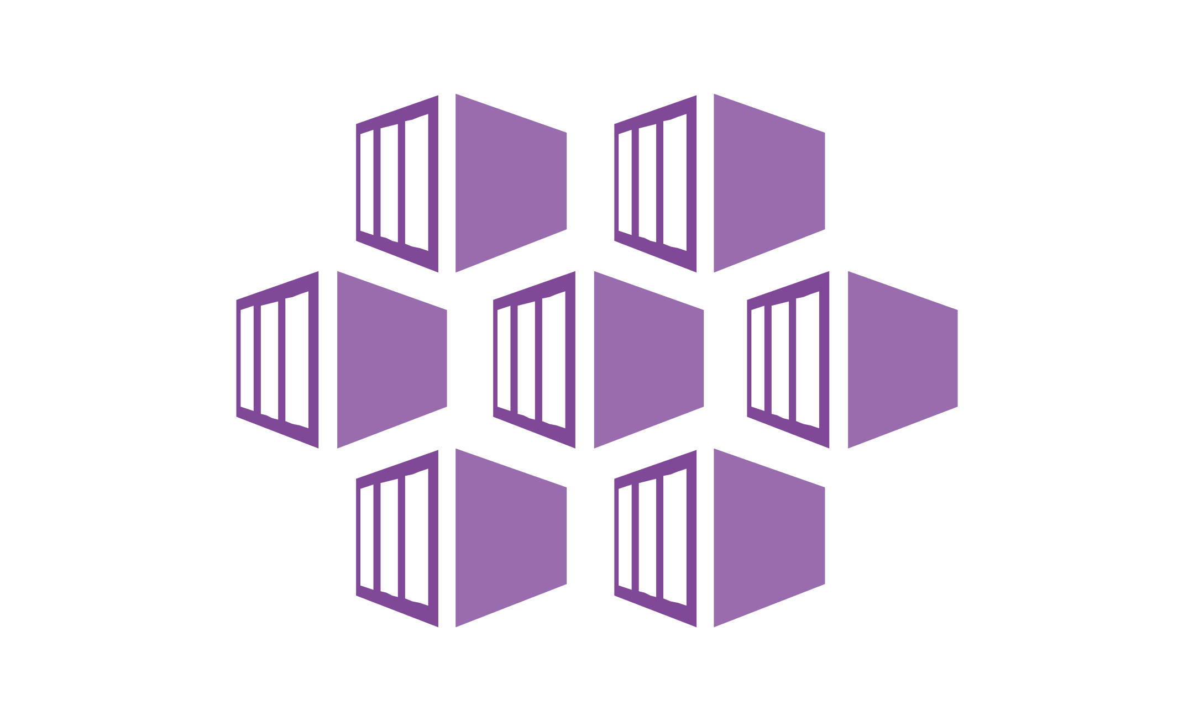


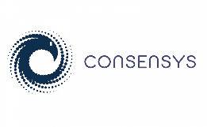
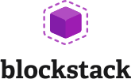



Build and run open source solutions
Any tool, application, framework
Applications
DevOps
Frameworks
Databases & middleware
Containers
Infrastructure
Notes:
We’re heavily invested in open-source technologies and partnerships, as evidenced on this slide. Nearly one in three Azure virtual machines are now running Linux, and we support Linux as a first class citizen.
Why is this important to Microsoft? Because it’s in the best interest of our customers. In fact, over 40% of CIOs are using open source as their primary strategy heading into 2017. We support our customers’ computing, whatever it is and wherever it is.
Finally, we contribute to the open source community as well as build some of our services on open source technology, like HDInsight and Azure Container Service. This also helps us scale to our customers’ needs as we rapidly release cloud solutions.

Slide 23













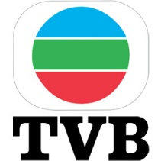






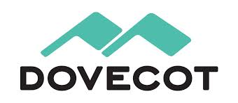

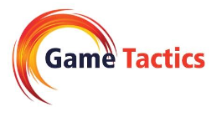






Open Source on Azure Customers
More customer stories at customers.microsoft.com!

Slide 24
ADD O365 OVERVIEW

Slide 25
Microsoft Linux
DevOps
Docker

Slide 26


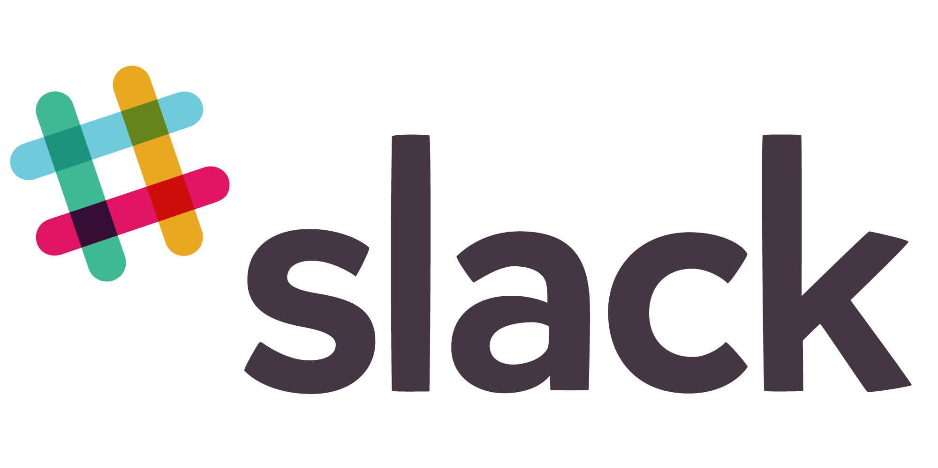












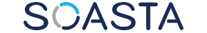





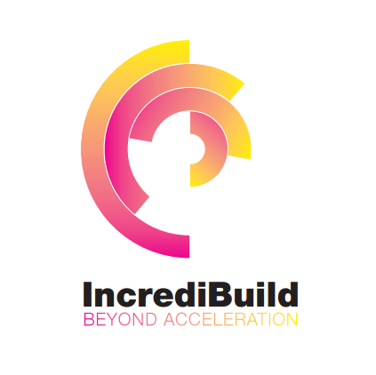






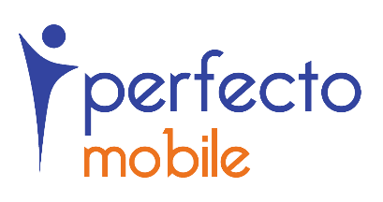






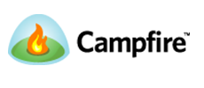

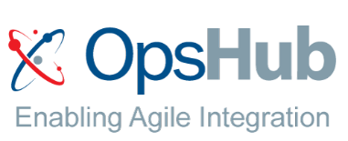

Open + Flexible Tool Chain
65
Visual Studio Code Extensions
5,910
Visual Studio Gallery Extensions
90
Visual Studio Sim-Ship Partners
48
VS Team Services Extensions
1,177 Visual Studio Code Extensions
6,538 Visual Studio Gallery Extensions
90 Visual Studio Sim-Ship Partners
171 VS Team Services Extensions
Notes:
Main point to land – VSTS/TFS is open, flexible, and integrates with your tools and if the integration isn‘t there yet you can build it in our marketplace. You can go all-in OR just pick the bits and pieces of functionality you‘d like to use.
Tasks are open source on GitHub.
Optionally choose some partners to highlight which resonate with your local audience. i.e. If you want to use GitHub for your source code and then use VSTS for builds you can do this. You can use Jenkins for builds and use VSTS for release management.

Slide 27
Visual Studio Online: DevOps
Code Repository
Build + Deploy
Load Testing
Release Management
Azure
Visual Studio
Eclipse / XCode
Application Insights and Hockey App

Slide 28
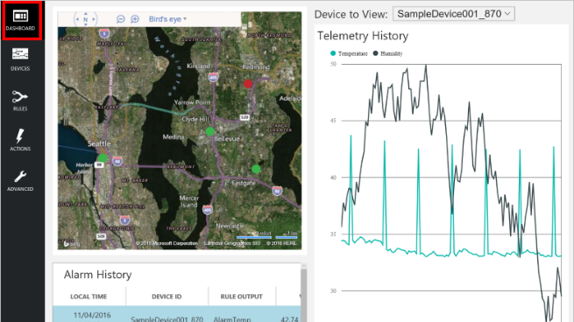
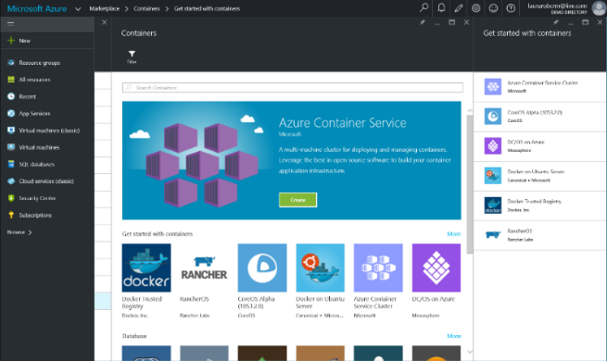
Build apps faster and easier
Build on PaaS
Azure
Internet of Things
Azure Marketplace
Existing frameworks
Web and mobile
Microservices
Serverless Compute
Build on IaaS
Virtual machines
Storage
Networking
Notes:
Building apps faster and easier means using the right building blocks for the job.
Starting from the bottom left, our core building blocks are storage, computing, and networking, or Infrastructure-as-a-Service, which provides customers with agility and cost savings.
When you add our integrated platform services, which run IaaS on the back-end, customers accelerate that agility. A recent study showed that customers using our platform as a service for app dev estimate 466% ROI than on just IaaS alone. This includes services across apps both small and internet-scale, data, integration, and so on.
In the middle, we’re packaging up services and capabilities to deliver preconfigured solutions such as with Azure IoT Suite. IoT is not a new concept in our industry, but it is extraordinarily difficult to deliver and maintain. In the past several years, the technology required to facilitate IoT solutions has improved dramatically, making it more accessible across industries and scenarios. Our IoT preconfigured solutions aim to further amplify that momentum, allowing companies to get to a working proof of concept in a fraction of the time than if they were building with individual components from scratch.
Finally, you can leverage full templates for web, mobile, containers, etc.--both first and third party--to get started in minutes rather than hours and days, through the Azure Marketplace. The screenshot here is our gallery of container templates, ranging from Docker to Mesosphere.

Slide 29
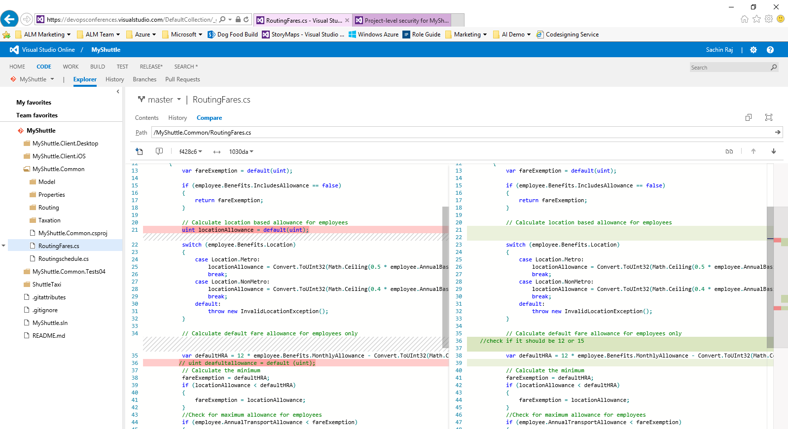
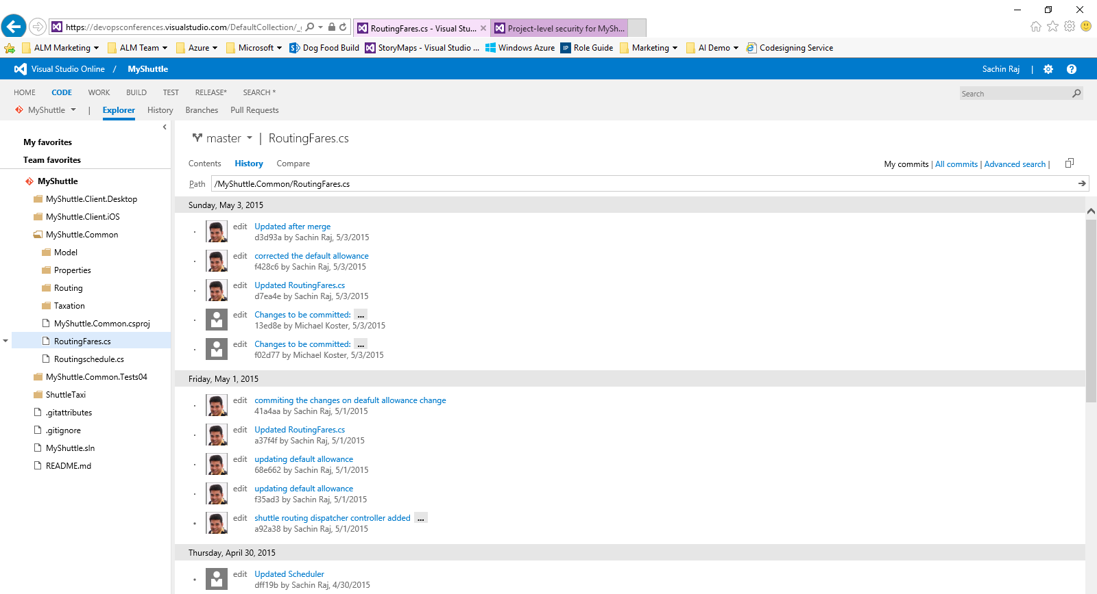
Visual Studio Online
Code Repository
Build + Deploy
Load Testing
Release Management
Azure
Visual Studio
Eclipse / XCode
Application Insights and Hockey App

Slide 30
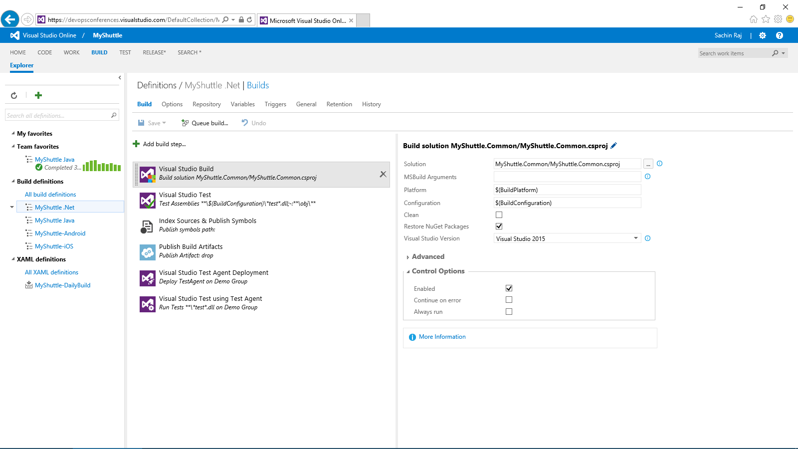
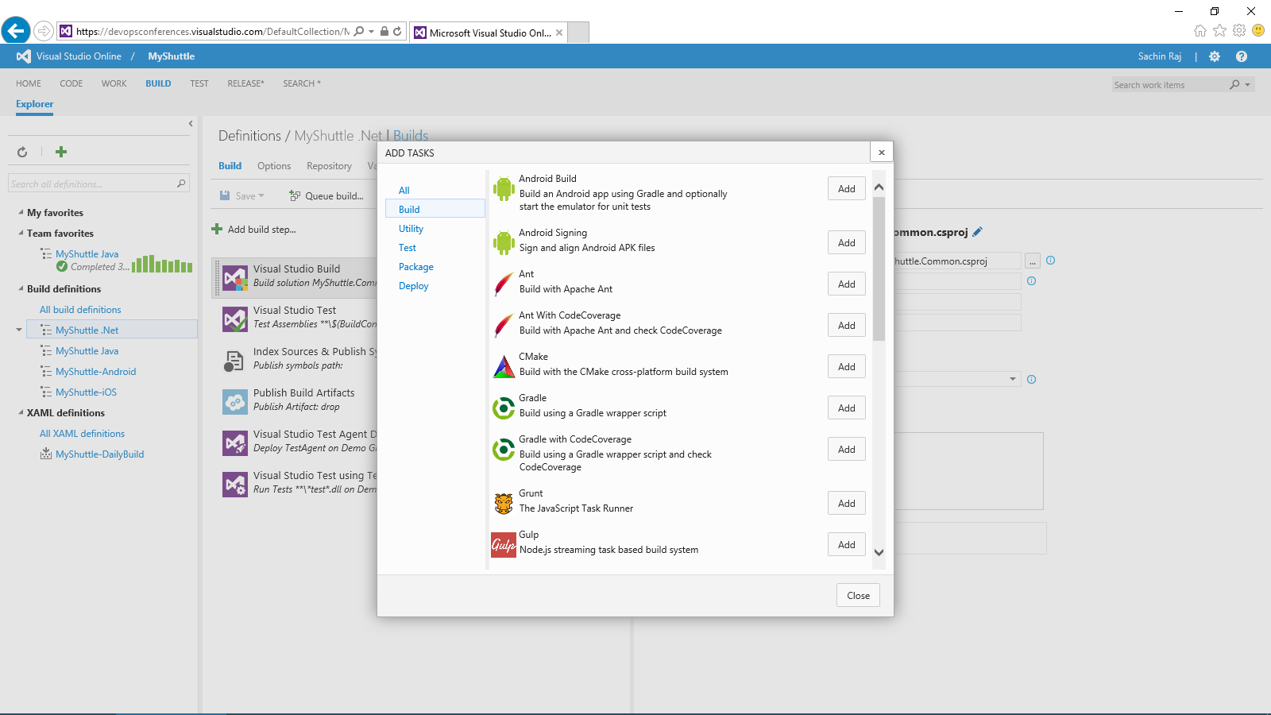
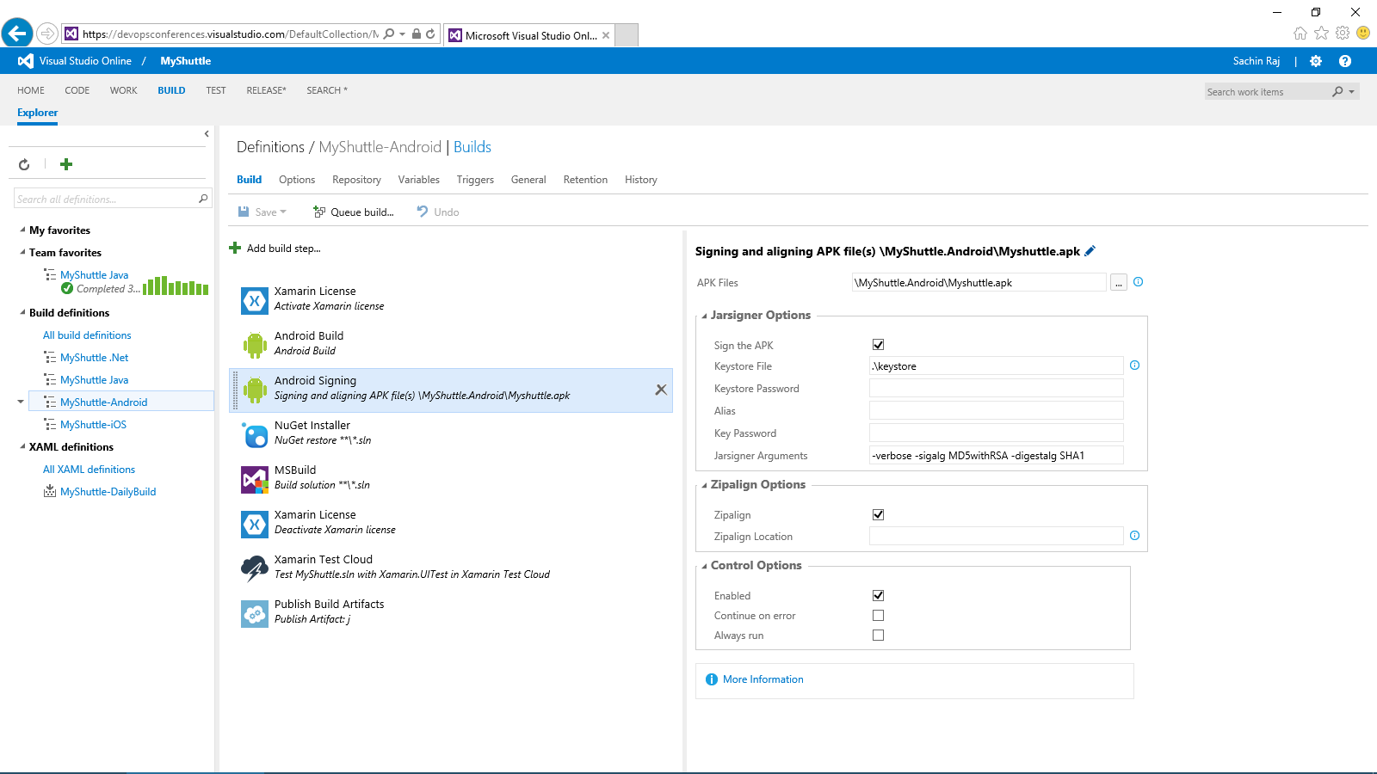
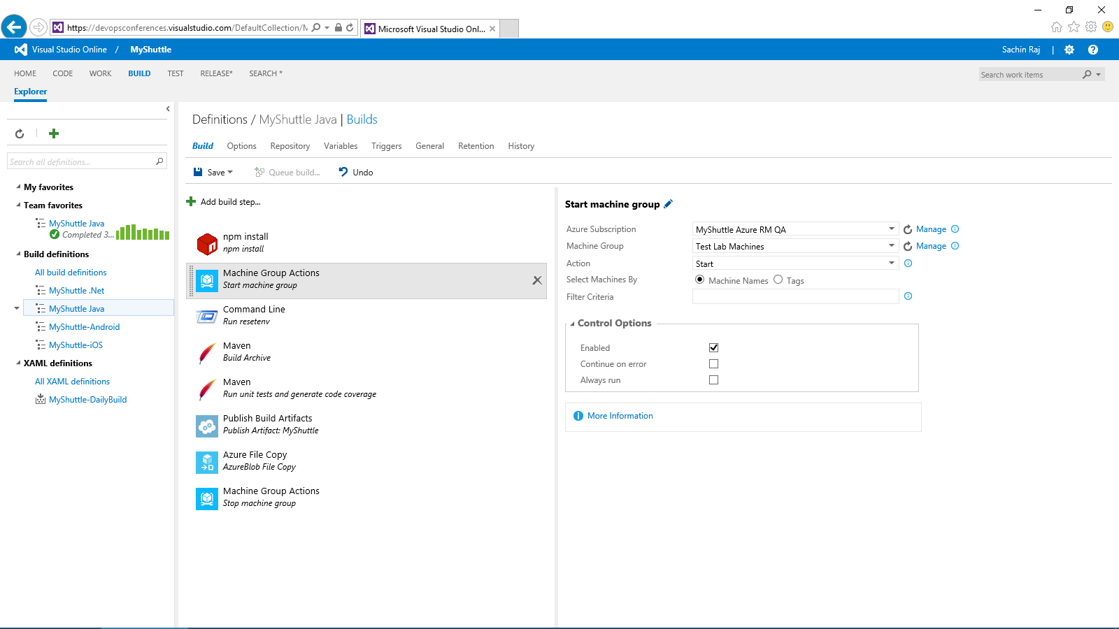
Visual Studio Online: Build + Deploy
Code Repository
Build + Deploy
Load Testing
Release Management
Azure
Visual Studio
Eclipse / XCode
Application Insights and Hockey App

Slide 31
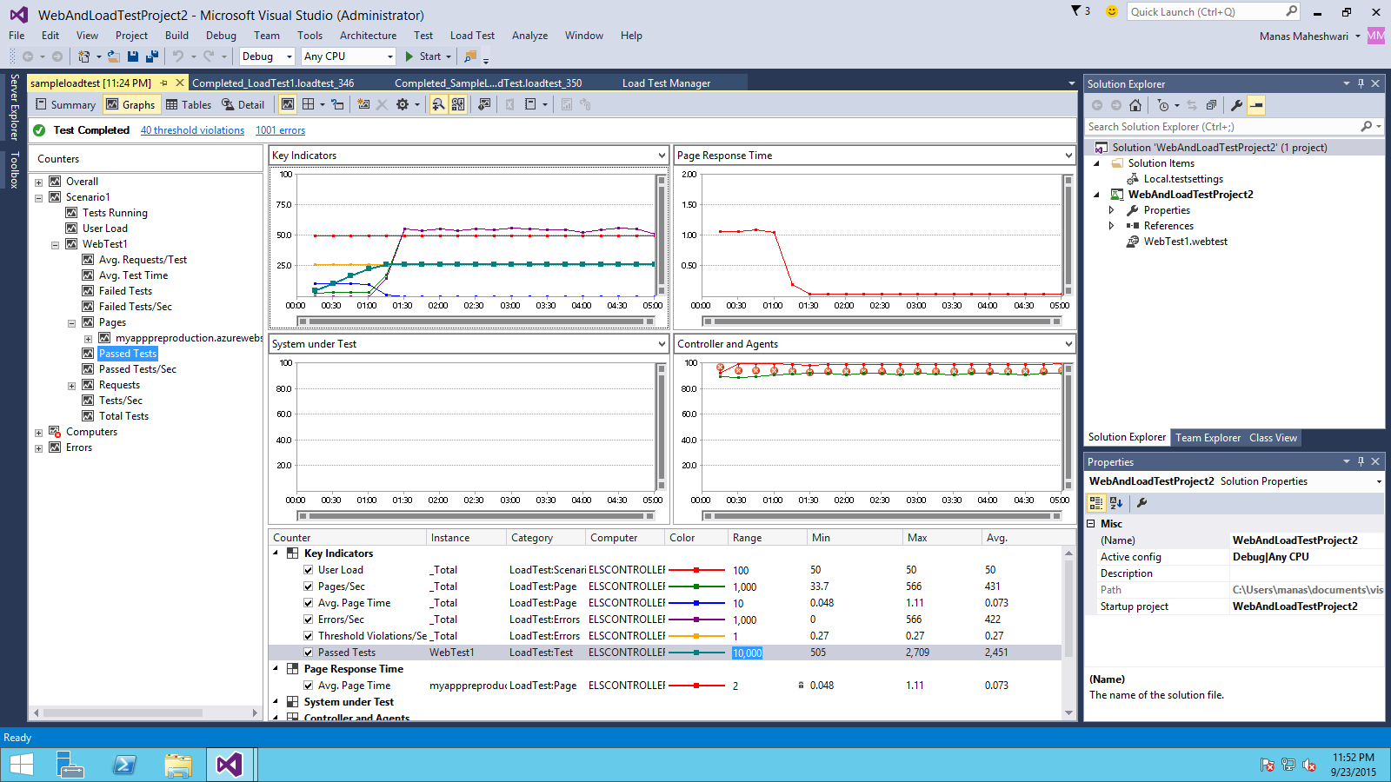
Visual Studio Online: Load Testing
Code Repository
Build + Deploy
Load Testing
Release Management
Azure
Visual Studio
Eclipse / XCode
Application Insights and Hockey App

Slide 32
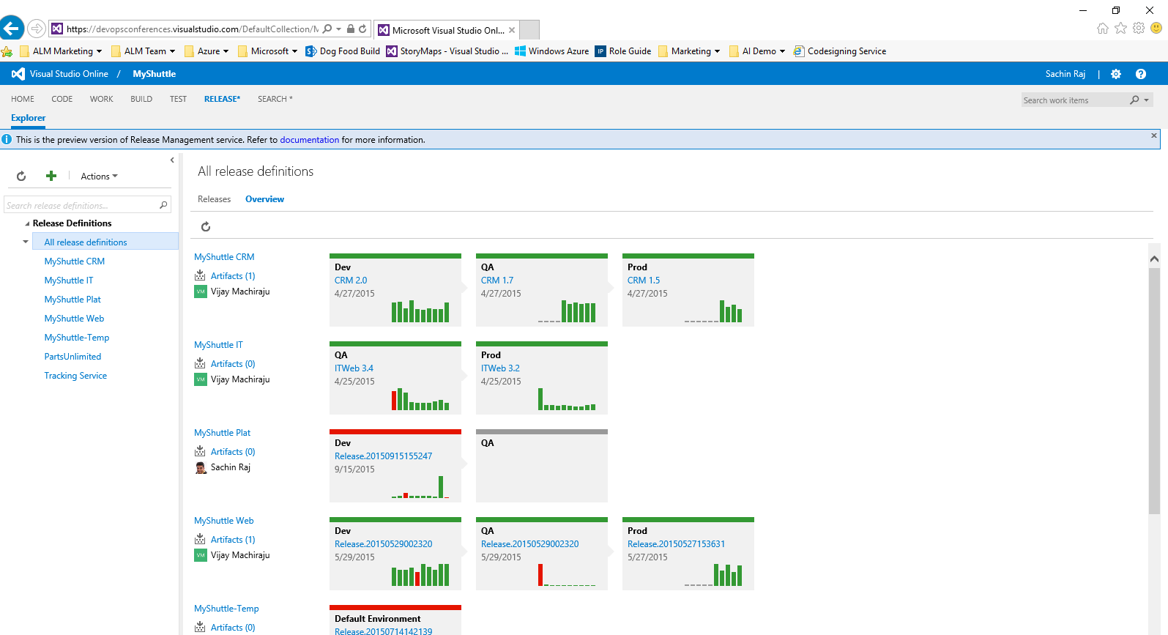
Visual Studio Online: Release Management
Code Repository
Build + Deploy
Load Testing
Release Management
Azure
Visual Studio
Eclipse / XCode
Application Insights and Hockey App

Slide 33
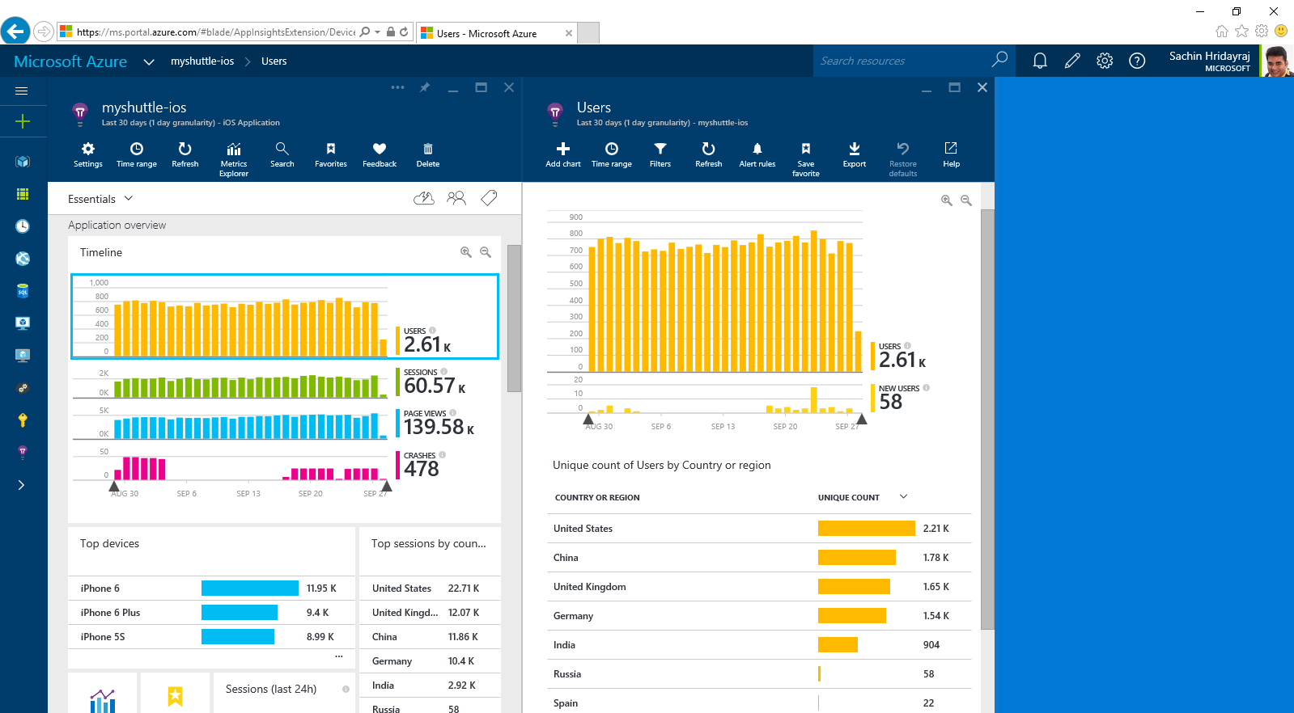
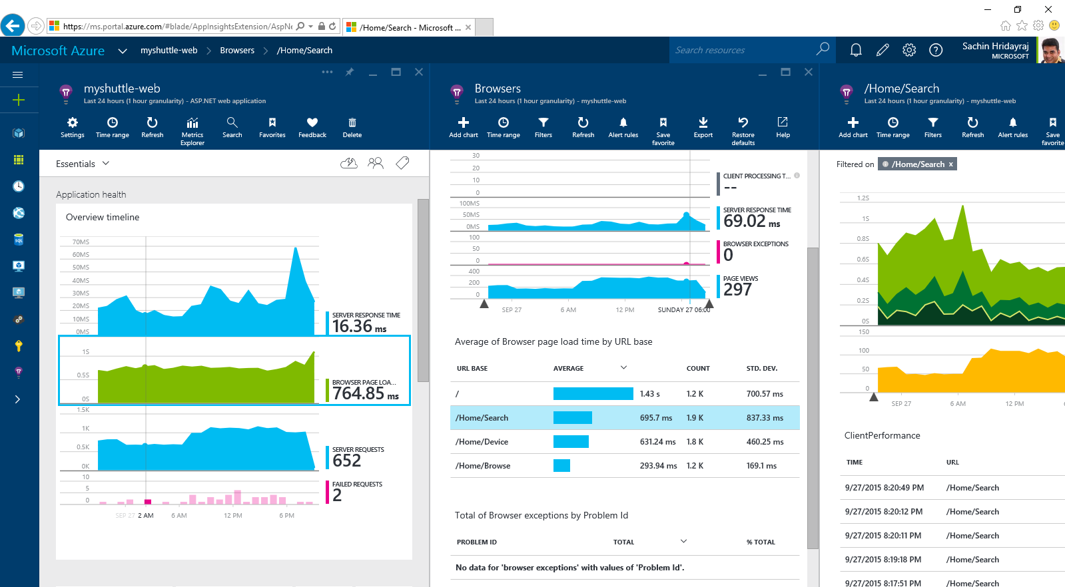
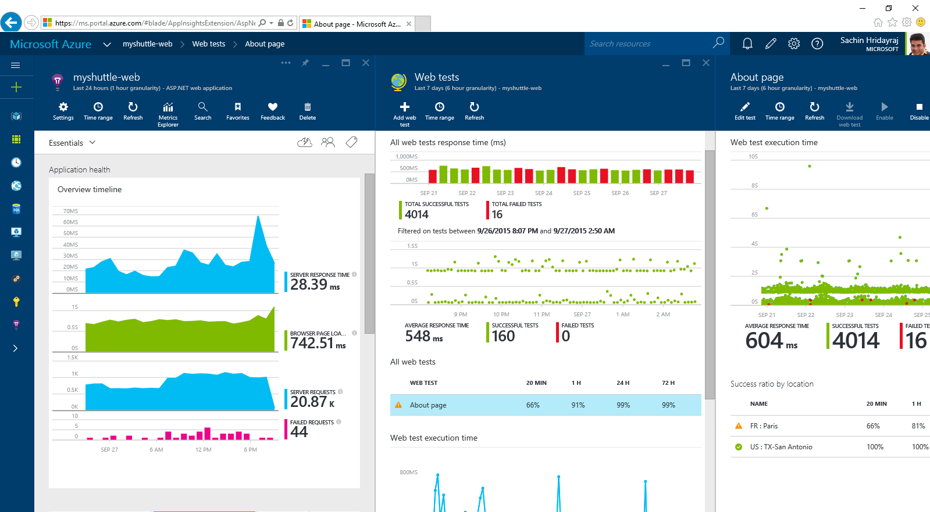
Visual Studio Online: Application Insights
Code Repository
Build + Deploy
Load Testing
Release Management
Azure
Visual Studio
Eclipse / XCode
Application Insights and Hockey App

Slide 34
Microsoft Linux
Docker
Docker

Slide 36
Summary

Slide 37
Questions?

